Slide 1
WBC count

Slide 2
Principle
A sample of blood is diluted with a diluting fluid which destroys the red cells and stains the nuclei of the leukocytes.
The cells are then counted in a counting chamber and their number in undiluted blood reported as leukocytes/mm³.

Slide 3
Normal WBC count
The normal cell counts ranges;
Adults = (4000 - 11,000$) cell{/mm}^{3}$
Average of 7000 ${cell/mm}^{3}$

Slide 4
Normal WBC count
Increased WBC count (Leukocytosis) is seen in;
No. | Physiological Leukocytosis | Pathological Leukocytosis
1. | Physical exercise | Acute infection
2. | Mental stress | Acute haemorrhage & burns
3. | Pregnancy | Malignancies
4. | Extremes of temperatures | Surgical operations
No.
Physiological Leukocytosis
Pathological Leukocytosis
1.
Physical exercise
Acute infection
2.
Mental stress
Acute haemorrhage & burns
3.
Pregnancy
Malignancies
4.
Extremes of temperatures
Surgical operations

Slide 5
Normal WBC count
Decreased WBC count (leukopenia) is seen in;
Pathological leukopenia;
Viral infection
Typhoid fever
Drugs
Malnutrition
Hypoplasia and aplasia
Notes:
Infection with non-pyogenic organisms: Typhoid and paratyphoid fevers, and sometimes in protozoal infection like malaria.
2. Viral infections: Influenza, mumps, smallpox, AIDS (Acquired immunodeficiency syndrome).
3. Drugs: Chloramphenicol, sulphonamides, aspirin, penicillins, cyclosporins, phenytoin, etc. Cytotoxic drugs used in treating malignancies may also cause leukopenis by depressing the bone marrow (other blood cells may also decrease).
4. Repeated exposures to X-rays and radium: These are used as radiotherapy in cancers, and cause bone marrow depression.
5. Chemical poisons that depress bone marrow: Arsenic, dinitrophenol, antimony and others.
6. Malnutrition: Deficiency of vitamin B12 and folate, general malnutrition, starvation, extreme weakness and debility.
7. Hypoplasia and aplasia: Partial or complete depression of bone marrow, i.e., failure of stem cells, may occur as a result of autoimmunity, and other factors.
8. Preleukemic stage of leukemias may show leukopenia.

Slide 6
Apparatus and materials
Microscope
Improved Neubauer chamber with coverslip
WBC pipette
Disposable blood lancet, sterile cotton, & 70% alcohol

Slide 7
Apparatus and materials
Turk’s fluid
This fluid is used for diluting the blood composed of;
Glacial acetic acid (1.5 ml) (hemolyzes RBCs without affecting WBCs).
Gentian violet (1% solution) (1.5 ml) (stains the nuclei of WBC).
Distilled water to (100 ml).

Slide 8
Procedure
Place about 1 ml of Turk’s fluid in a watch glass.
Examine the chamber, with the coverslip ‘centred’ on it, under low magnification.
Adjust the illumination and focus the right upper group of 16 WBC squares.

Slide 9
Procedure
Move the chamber to your work-table for charging it with diluted blood.
Filling the pipette with blood and diluting it;
Get a finger-prick.
Wipe the first 2 drops of blood and fill the pipette up to the mark 0.5.
Suck Turk’s fluid to the mark 11 and mix the contents of the bulb for 3–4 minutes.

Slide 10
Procedure
Charge the chamber with diluted blood.
Move the chamber to the microscope and focus the grid to see the WBC square.
Wait for 3–4 minutes for the cells to settle down.
The leukocytes appear as round, shiny, darkish dots, with a halo around them.

Slide 11
Procedure
Counting the cells
Count the WBCs in 16 squares under low power.
Count the cells in the 4 groups of 16 squares each.

Slide 12
The counting grid
The 4 large corner squares (WBC squares) are lightly etched, with single lines.
Each of these 4 squares are divided into 16 medium squares with single lines.
Notes:
Each of the large corner squares are divided by single lines into 16 medium-sized squares each of which has an area of 1/16 mm² (1/4 mm × 1/4 mm).

Slide 13
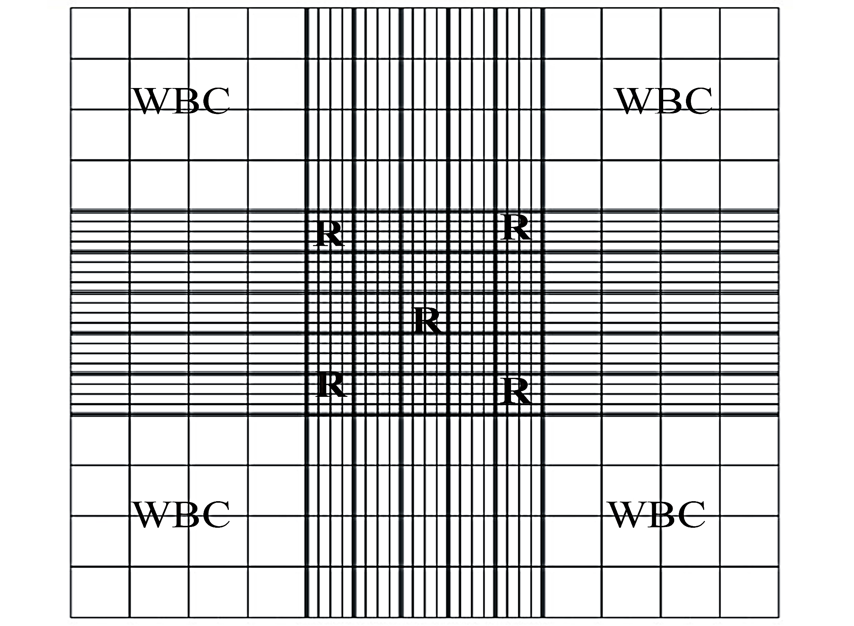

Slide 14
1 mm
Length of the square= 1 mm
Width of the square= 1 mm
Depth of the square= 1/10 mm
Area of the square=1 * 1= 1 ${mm}^{2 }$
Volume of the square= 1 * 1/10= 1/10 ${mm}^{3}$
Volume of 4 squares= 1/0 * 4= 4/10 ${mm}^{3}$
WBC
1 mm

Slide 15
Rules for counting
Cells lying within a square are to be counted with that square.
Cells lying on or touching its lower horizontal and left vertical lines are to be counted with that particular square (L shape rule).

Slide 16
Rules for counting
Cells lying on or touching its upper horizontal and right vertical lines are to be omitted from that square because they will be counted with the adjacent squares.

Slide 17
Observations and results
Add up the number of cells in each of the 4 blocks of 16 medium squares.
A difference of more than 20 between any 2 blocks indicates uneven distribution.

Slide 18
Observations and results
Calculation of dilution factor
The volume of the bulb is 10
This gives a dilution of 0.5 in 10, or 1 in 20
The dilution factor = 1/20

Slide 19
Observations and results
We can calculate the number of WBC as shown below:
The volume of calculated area= 4/10
The dilution factor = 1/20
The diluted volume =4/10 * 1/20 = 1/50 ${mm}^{3}$

Slide 20
Observations and results
If cell counted = M
WBC count = $\frac{ M∗1 }{ \frac{ 1 }{ 50 }}$
WBC count (${cells/mm}^{3}$) = M * 50

Slide 21
Observations and results
Express your result as ..... cells${/mm}^{3}$.
The normal cell counts ranges;
Adults = (4000 - 11,000$) cell{/mm}^{3}$
Average of 7000 ${cell/mm}^{3}$

Slide 22
PRECAUTIONS
Observe all precautions described for getting a finger-prick, filling the pipette, and charging the counting chamber.
Keep all equipment ready before getting a prick.

Slide 23
PRECAUTIONS
When mixing the blood with the Turk’s fluid, give sufficient time for complete hemolysis of red cells.
Continuously “rack” the microscope while identifying and counting the cells.

